Slide 1

Ashiana: Your Home Nearby
Presented by: Priyanshu Sharma
Roll No.: 12200974
Guide: Dr. Ridhi Kapoor
Department of Computer Science & Engineering, D.A.V. University Jalandhar
Batch: 2022–2026
COMPUTER SCIENCE AND ENGINEERING

Slide 2
The Challenge: Navigating the Unorganised Rental Market
Disorganized Process
Trust Deficit for Tenants
The current property rental landscape often lacks structure, making it difficult for both tenants and landlords to connect efficiently.
Prospective tenants frequently face challenges in finding reliable properties and trustworthy landlords, leading to uncertainty and wasted effort.
Landlord Inefficiencies
The Solution
Property owners struggle with manual listing management, advertising, and tenant communication, consuming valuable time and resources.
A critical need exists for a centralised digital platform to streamline the entire renting process.

Slide 3










Ashiana: Revolutionising Property Rentals
Ashiana is a sophisticated, web-based platform designed to seamlessly connect landlords with prospective tenants, offering an intuitive and efficient rental experience.
Effortless Property Listing & Management
Advanced Search & Filtering
Secure Authentication
Tenants benefit from powerful search functionalities, allowing them to filter properties by location, price range, property type, and more.
Robust user registration and login ensure secure access for both landlords and tenants, protecting personal and property data.
Landlords can easily create, update, and manage their property listings with comprehensive details and high-quality images.
Integrated Communication System
Responsive User Interface
A built-in messaging system facilitates direct and secure communication between interested parties, streamlining inquiries and viewings.
The platform is designed for optimal viewing and interaction across various devices, from desktops to mobile phones, ensuring a consistent user experience.

Slide 4





Our Core Objectives for Ashiana
Security & Efficiency
To provide a secure and highly efficient platform for all rental transactions, safeguarding user data and simplifying processes.
Simplified Workflow
To significantly streamline the property listing, searching, and renting workflows for both landlords and tenants.
Enhanced Transparency & Communication
To foster clear communication and build trust by providing transparent information throughout the rental journey.
Scalability & Future Growth
To build a robust and scalable architecture that can accommodate future features and an expanding user base.

Slide 5
Leveraging the Power of the MERN Stack
Ashiana is built upon the MERN stack, a powerful and popular technology choice for modern web applications.
MERN Stack Components
Key Benefits of MERN
MongoDB: A flexible NoSQL database for efficient data storage.
JavaScript Everywhere: Consistent language for both frontend and backend development.
Express.js: A robust backend web framework for Node.js.
Modular Design: Enables scalable and maintainable code architecture.
React.js: A declarative and efficient JavaScript library for building user interfaces.
High Performance: Non-blocking I/O operations in Node.js enhance application speed.
Node.js: A JavaScript runtime for server-side development.
Extensive Ecosystem: Access to a vast array of libraries and tools.
CSS: For modern and appealing styling.
Scalability: Designed to handle increasing user loads and data volumes effectively.

Slide 6

Ashiana's Robust System Architecture
Client (React)
Interactive UI handling client-side logic and requests.
Server (Node.js)
API layer with Express.js routing and business logic.
Database (MongoDB)
Persistent document store for application data and queries.
Ashiana employs a classic three-tier architecture to ensure optimal performance, scalability, and maintainability.
Client (React)
Server (Node.js + Express.js)
Database (MongoDB)
The interactive and responsive user interface, handling all client-side logic and user interactions.
The backend layer responsible for API management, business logic, user authentication, and data processing.
A NoSQL database storing all critical information, including user profiles, property listings, and messaging data.

Slide 7





The Ashiana User Journey: A Seamless Workflow
User Authentication
Landlord Listing
Tenant Search
New users register, and existing users securely log in to access the platform's features.
Landlords submit detailed information and photos for their properties, making them available for viewing.
Tenants browse listings using advanced filters (location, price, type) to find ideal properties.
Property Viewing & Contact
Backend Operations (CRUD)
Tenants can view comprehensive property details and use the integrated system to contact landlords directly.
All Create, Read, Update, and Delete operations for listings, users, and messages are efficiently managed by the backend.

Slide 8
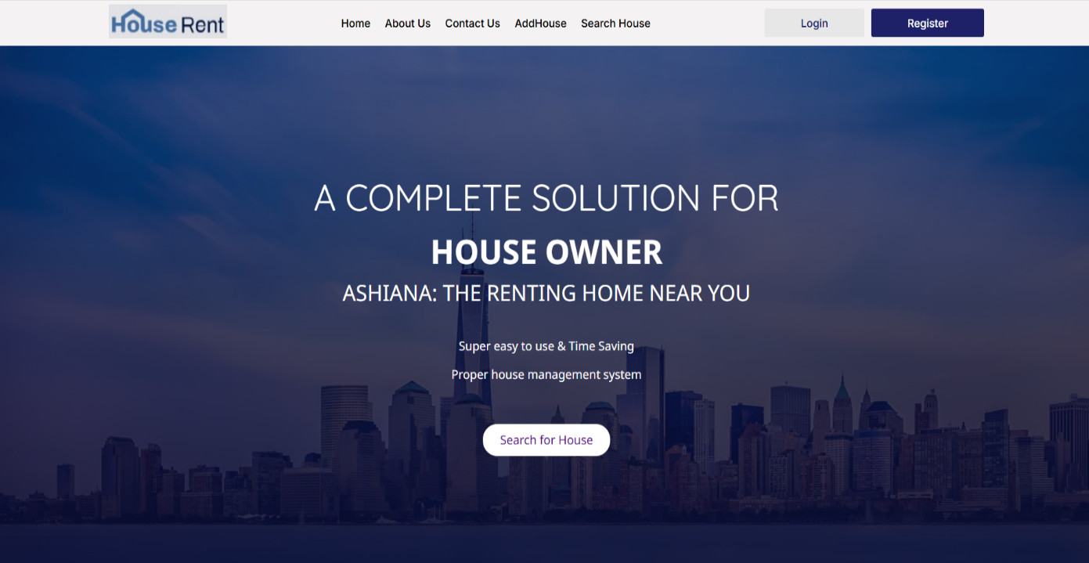
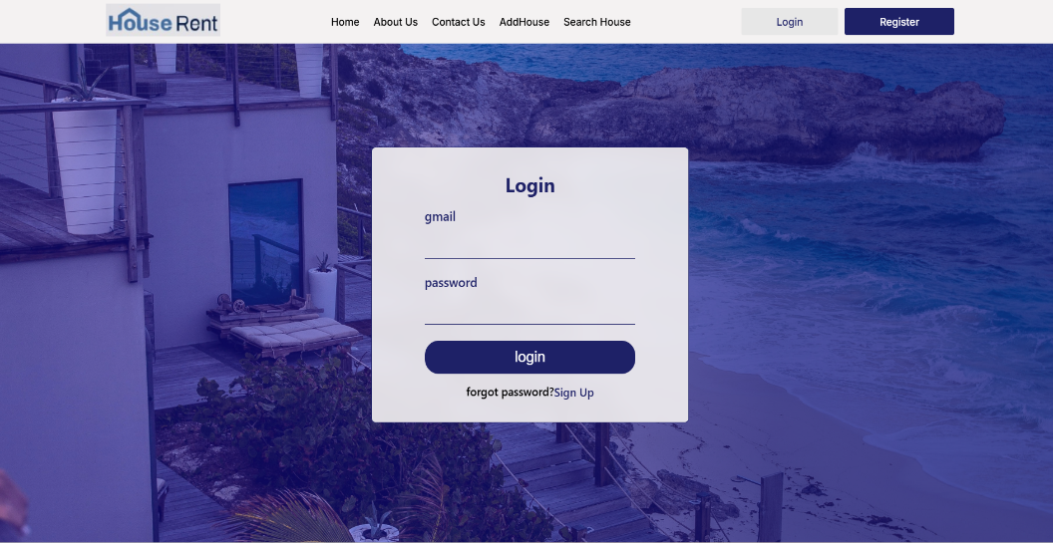
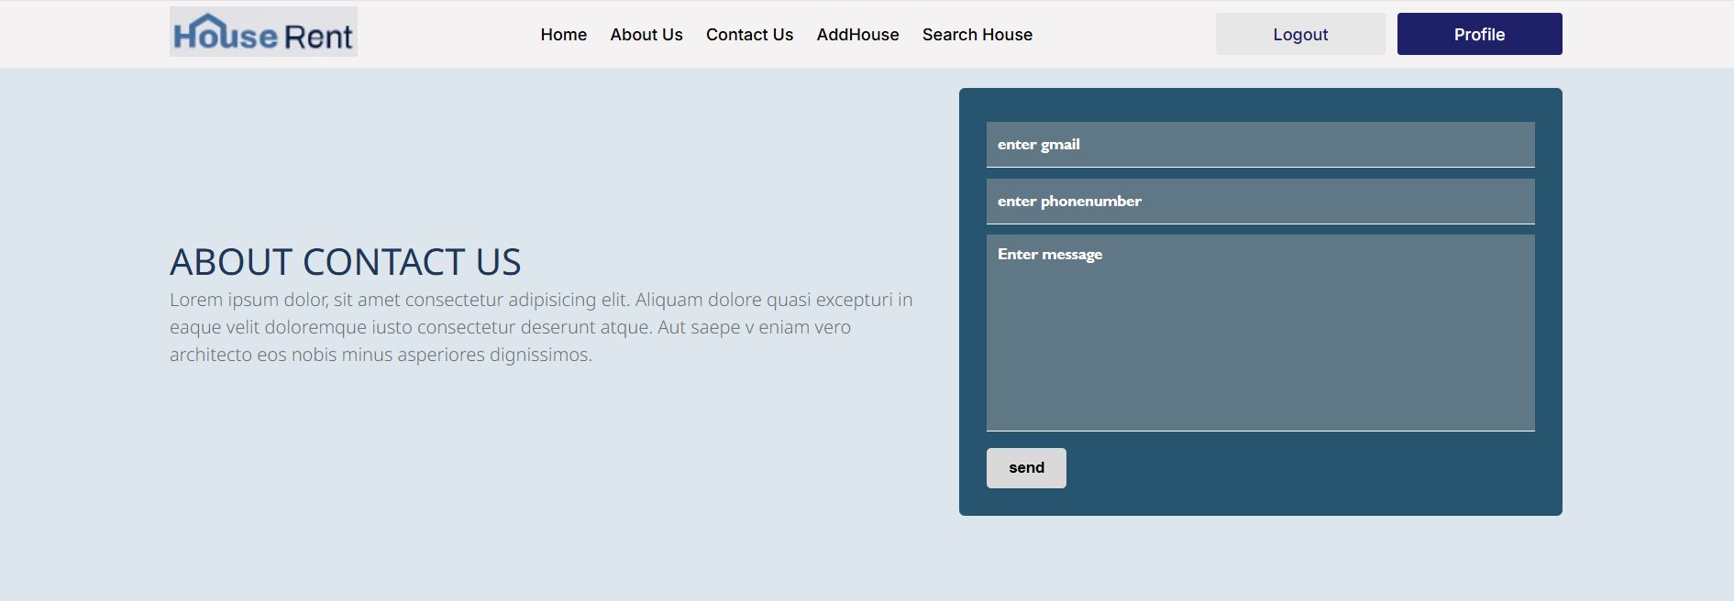
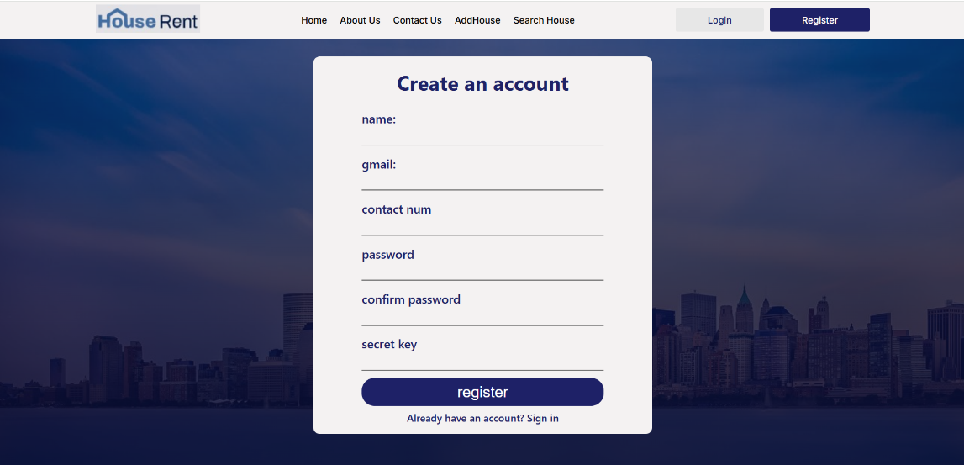
Ashiana: System Implementation Details
Ashiana is developed with a focus on modern development environments and robust technologies to ensure a smooth and efficient application.
Hardware Specifications
Implementation Screenshots
Laptop: A standard development machine.
RAM: Minimum 8GB for optimal performance during development and testing.
Software Environment
Operating System: Windows 11 for a modern and compatible development experience.
IDE: Visual Studio Code, a powerful and versatile code editor.
Database Management: MongoDB Atlas, a cloud-based database service for scalability and ease of use.
Technology Stack: MERN Stack (React, Node.js, Express.js, MongoDB).

Slide 9



Envisioning Ashiana's Future: Enhanced Features
Our vision for Ashiana extends beyond the current functionalities, aiming to incorporate advanced features that will further enrich the user experience.
Payment Gateway Integration
Securely handle rental payments and deposits directly through the platform.
AI-Powered Recommendations
Implement smart algorithms to suggest properties tailored to tenant preferences and search history.
Real-time Chat System
Enable instant messaging between landlords and tenants for quick communication and query resolution.
Smart Filters with AI
Develop more intelligent filtering options, potentially using AI to understand nuanced search requests.

Slide 10



Conclusion: Ashiana - The Future of Renting
Ashiana, a MERN-stack based renting system, marks a significant step forward in simplifying and optimising the property rental market.
Improved Efficiency & Transparency
Robust & Flexible Design
Leveraging secure authentication, a flexible database, and a responsive design, Ashiana offers a reliable and adaptable solution.
The platform dramatically enhances the efficiency and transparency of the rental process for all stakeholders.
Enhanced User Interaction
It fosters seamless and effective interaction between landlords and tenants, building a more connected and trusting rental community.

